Slide 1

Scalable ML Pipelines
Predicting Used Car Prices
Elizaveta Litvinova (J4234c)
Egor Udalov (J4234c)
Сухроб Мунаваров (J4234c)
Etietop Abraham (J4134c)

Slide 2
Outline
Objective
Why?
EDA
Infrastructure
Libraries
Spark Pipeline Stages
Kafka Data Streaming
Production Demo
Challenges

Slide 3
Objective
KUBERNETES
Aims to create an end-to-end prediction pipeline that efficiently utilizes resources, leverages distributed computing with Spark, and can handle real-world data challenges in the domain of used car pricing.
SPARK PIPELINES
KAFKA STREAMING

Slide 4
Exploratory Data Analysis
Records
3 Million
Features
65
Missing cells
23.1%

Slide 5
Exploratory Data Analysis
Correlation
 | engine_displacement | horse_power | year | engine_type | franchise_make
price | 0.375 | 0.613 | 0.605 | 0.528 | 0.274

Slide 6
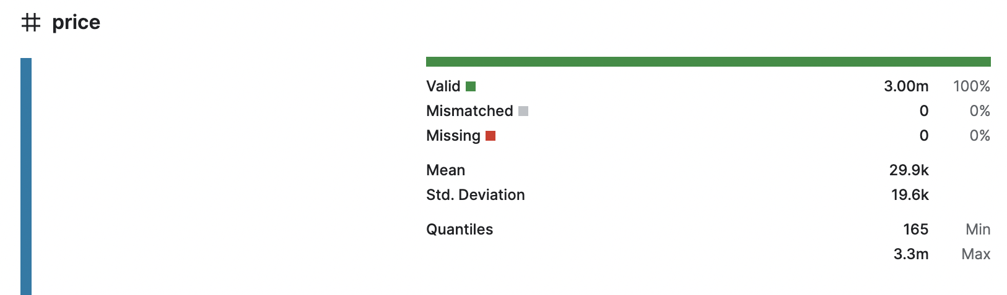
Exploratory Data Analysis

Slide 7
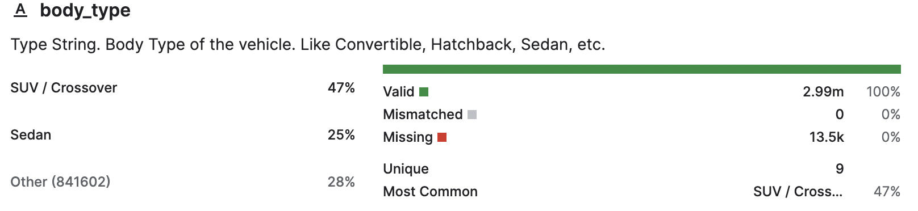
Exploratory Data Analysis

Slide 8
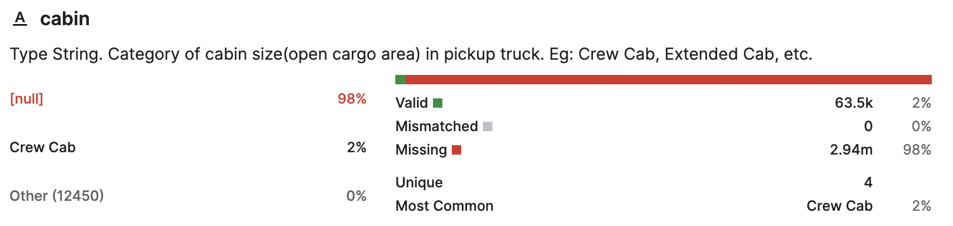
Exploratory Data Analysis

Slide 9
Infrastructure
Poetry for Dependency Management
Wide range of dependencies for varied tasks, like big data processing (pyspark), data streaming with Kafka, etc.
Kubernetes Deployment
Single replica, resource limits (32Gi memory, 12 CPUs), and volume mounts for shared data and configuration.
04
01
03
Containerization with Docker
Docker image based on PySpark, HDFS, Jupyter, and other dependencies
Executor Pod Configuration
2 Executors with limits of 12 cpus, and 32Gi memory.
02

Slide 10






Packages
…

Slide 11
Spark Pipeline Stages
Data Cleaning
Select columns
Drop rows with NaNs (3%)
Features type set as string
Extract new features
Encoded categorical features via K-Fold Mean Target Encoder
NaN Columns replaced with median/top-class
Glove Encode categorical columns with high number of unique values
Feature selection
Permutation Importance
stacking model important values
Cross-validate important features
Base models tuning & training
Cross-validation
Grid Search
70 or 80 Features (depends on base model)
Data Conversion
CSV to Parquet
Stacking model tuning & training
Cross-validation based training
Grid Search for tuning
Data Preparation
Min-Max Scaler
Missing values imputer models
Models used as imputer models:
linear, random forest and logistic regression
200 Features
Predictions & Metrics
Calculating predictions
Calculating metrics

Slide 12
Spark Pipeline Stages
Features
Base model | Linear Regression | Random Forest Regression | GBT Regression
Number of top features | 70 | 80 | 70
CV R2 score | 0.591 | 0.604 | 0.666
A set with a relatively high R2 score and as few features as possible is chosen for each base model

Slide 13
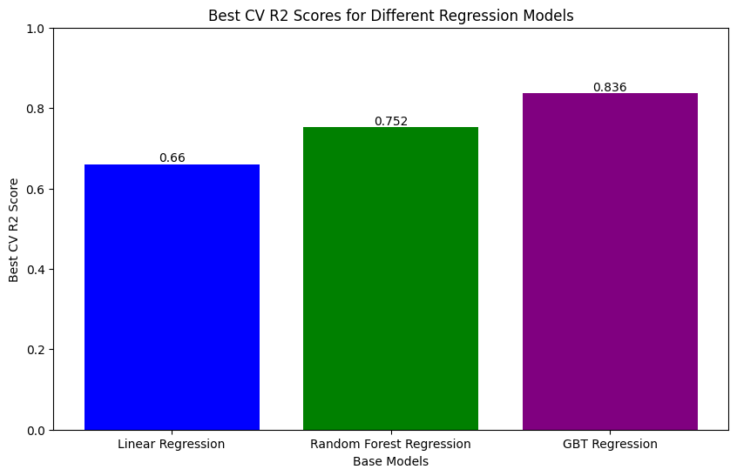
Spark Pipeline Stages
Base Model

Slide 14
Spark Pipeline Stages
Stacking Regressor Training and Tuning
Meta model | Linear Regression
Best R2 score | 0.840
Linear Regression was used as a meta model
Meta model was trained on first-level predictions using Cross Validation approach, when making first-level predictions
Meta model was tuned via Grid Search

Slide 15
Kafka Data Streaming
Topics
Objects
P0
P1
P2
P3
P4
P5
Producer («outer server», we imitate)
Consumer group (inner)
.parquet file with new data
C0
C1
C2
C3
C4
C5

Slide 16
Kafka Data Streaming
Topics
Predictions
VIN | Price (predicted)
Producer (inner)
Predictions
(«outer topic», we imitate)

Slide 17
Kafka Data Streaming
Topics
Prices
P0
P1
P2
P3
P4
P5
Producer («outer server», we imitate)
Consumer group (inner)
.parquet file with prices
C0
C1
C2
C3
C4
C5

Slide 18
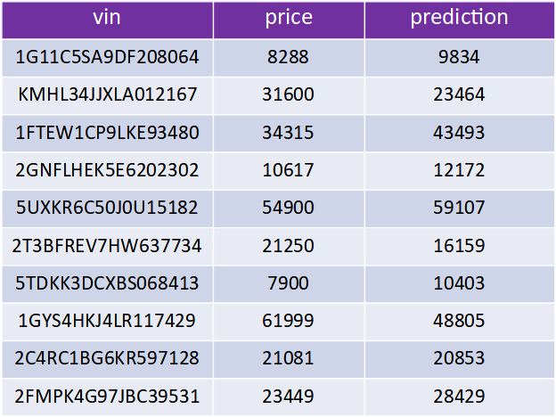
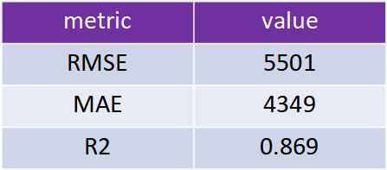
Results from test data stream

Slide 19
Challenges
Problematic parts:
Finding a better way and place to use caching when it is crucial to do so
Implementing stages, so that each can run in a one go for the training data
Bug related error in the Data Preparation stage when running the stage for the training data (still not resolved)
Version compatibility
Resource distribution
Interesting parts:
Implementing K-Fold Mean Target Encoder from scratch (with necessary modifications)
Implementing Permutation Importance based Feature Selection algorithm from scratch
Implementing CV based training of a Stacking Model from scratch
Working with Kafka & Spark

Slide 20
Thank you for your attention!

